Slide 1
EE222 High-Speed Low-Power ICs
Spring 2017
Instructor: Sung-Mo “Steve” Kang
Room BE-239
skang@ucsc.edu
(831)502-7052
Acknowledgments- Prof. Eby Friedman of the University of Rochester and Prof. Yusuf Leblebici of EPFL have provided
Lecture materials.

Slide 2
Time and Place
4:00 to 5:05 PM, M, W, and F
Baskin Engineering Bldg. Room 156

Slide 3
Course Contents
Technology
Technologies
SemiconductorMaterials
Solid-State
Device Physics
Applications
Computers
IoT, Sensors
Image Processing
Wireless
DSP
Biomedical Apps
⇒ ⇒
VLSI IC
Design
Will attempt to integrate technology issues and application issues into the topic of VLSI design
  Which technology for which application?
  Speed, area, power, complexity, I/O interface, especially LOW POWER is critical
  Digital or analog?
  On-chip A/D? Mixed-signal?
  Single large chip or multiple small chips?
  Printed circuit board (PCB), MCM, WSI, 3-D
    - Systems integration issues

Slide 4
Summary of Course Organization
Introduction- VLSI design issues and technologies
Low Power (LP) CMOS Logic
LP Design Flow
CMOS power dissipation
5. LP Biomedical Circuits and Systems
6. CMOS Circuits Power Basics
Interconnects
Custom Ips, Library
9. Semiconductor Memories
10. Project Proposals
High Speed (HS) Architecture and Timing
Multiple Clock Domains
Synchronous Design
Asynchronous Design
Technology Scaling
Packaging
Reliability
Final Presentations

Slide 5
Design Methodologies
Semi-custom
PLD/FPLD/ Gate Arrays Standard cells Structured Full
PLA/FPGA SOG’s core cells custom custom
Lower NRE
Longer design time
Higher complexity
Lower RE
Higher speed
Higher volume
Lower Power

Slide 6
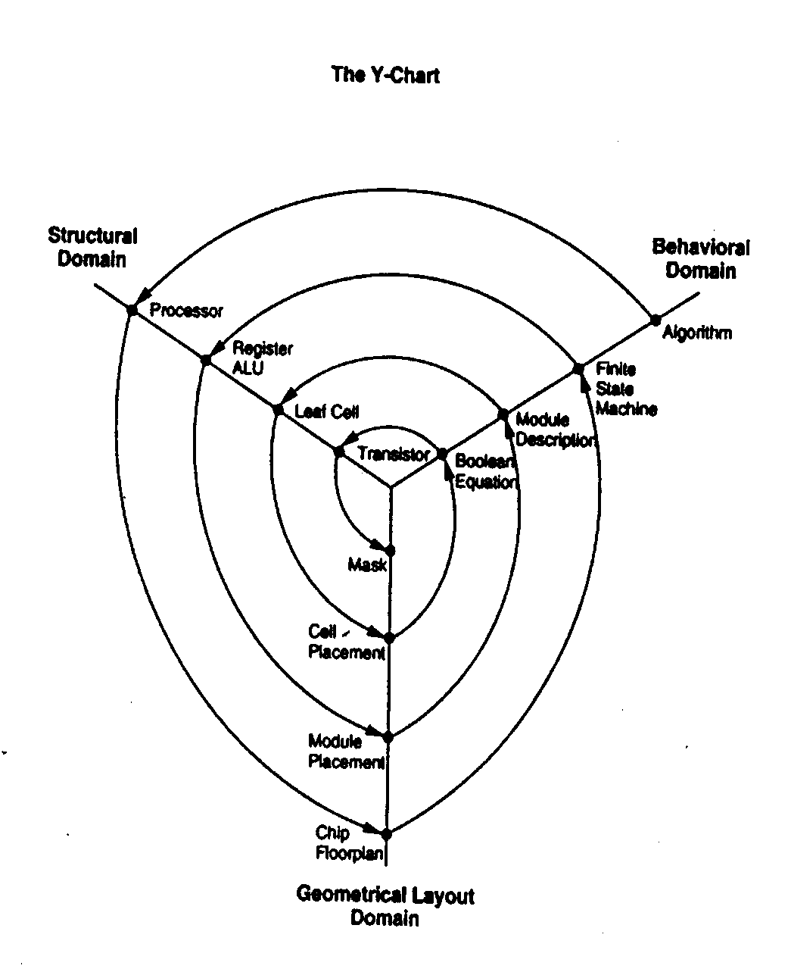
Complexity vs. Year and the Y–Chart
• Microprocessor
⬧ Memory
10⁸
–
100
5 x 10⁷
–
16M
–
10⁷
Transistors per die
4M
⋅
⋅
Pentium
⋅
⋅
DEC Alpha
1M
⋅
10⁶
–
80486
68040
–
250K
80860
⋅
⋅
⋅
⋅
⋅
68030
80386
–
64K
Bellmac
68020
–
10⁵
⋅
80286
32A
68000
⋅
16K
⋅
8066
4K
⋅
8048
–
10⁴
–
⋅
1K
8085
⋅
⋅
8080
8008
Source: Intel Corp.
4004
10³
1970
1980
1990
2000
Level of integration versus time, for memory chips and logic chips
Typical VLSI design flow in three domains (Y-chart representation)
D. D. Gajski (Ed.), Silicon Compilation, Addison Wesley, 1988

Slide 7
Levels of Design
Structural
domain
Behavioral
domain
Processor, Memory, switch
Systems
Hardware modules
Algorithms
ALUs, MUXs, registers
Register transfers
Gates, flip-flops, cells
Logic
Transistors, contacts, wires
Transfer functions
Layout
Modules
Floor plans
Clusters
Physical Partitions
Physical domain
Levels of design in the tripartite representation
Dan Gajski’s Y-chart

Slide 8
Performance Issues in VLSI/IC Design and Analysis
What is design in VLSI/IC?
Levels of Abstraction
Technology
Process
Device
Geometric
Circuit
Logic
RTL - structural
Behavioral
Systems
This class will focus here

Slide 9
Integrated Circuit Design Flow
System requirements
and specifications
Architecture
definition
Behavioral
description
Architecture level
Logic design
Structural
description
Register transfer level
Circuit design
Circuit design
Physical
description
Physical level
Layout design
Fabrication
Layout design
Testing

Slide 10
A Host of VLSI/IC CAD Problems Exist
Cell generation
Testability improvement
Automated layout: 1-D, 2-D, and hierarchical
Logic optimization
Logic synthesis
RTL synthesis
HDL/Behavioral synthesis
Back annotation
Timing analysis
Circuit simulation and modeling
Mixed mode simulation
Sequential machine optimization and synthesis
Register allocation
Process simulation, modeling and tolerance
Device simulation
Analog synthesis,Test
Analog simulation
Tool integration

Slide 11
Research in IC CAD Tools/Design Systems
Synthesis
Simulation/Modeling
Verification
Testing
Technology
Process
Device
Geometric
Circuit
Logic
RTL
Behavioral
Systems/Applications
Process Simulation and
Modeling and Tolerancing
Device Simulation
Circuit Modeling
Back Annotation/
Parasitic Extraction
Circuit Simulation
Analog Simulation
Timing Analysis
Logic Simulation
Verilog
HDL/Behavioral
Simulation
DRC
LVS
Tool
Integration
Symbolic Layout
Analog Synthesis
FPGA Tools
Cell Generation
Automated Layout
Logic Optimization
Sequential Machine Opt. and Syn
Module
Generation
Logic Synthesis
Register Allocation
Retiming
RTL Synthesis
HDL Behavioral Synthesis
ERC
BIST
DFT
ATPG
LVS
Mixed Mode
Simulation
HDL
Verification

Slide 12
Technologies
Bipolar (SiGe)
NMOS
CMOS * Main Focus of EE222
GaAs
FinFET (Used for Deep Submicron CMOS)
ModFET
HEMT
Superconductor (Josephson Junctions)
Others
Focus of this class is on studying
  How circuit level parameters interact with technology
  Systems level issues and how overall performance is affected

Slide 13
Integrated Circuit Technologies – Tradeoffs
Bipolar and NMOS are older technologies
- Many circuit design approaches are directly relatable to BiCMOS, GaAs, and CMOS
Different technologies lean toward different applications
NMOS ⇒ high density, medium speed, and medium power
Replaced by CMOS, which is NMOS and PMOS
CMOS ⇒ high density, medium speed, and very low power (8 to 12 masks)
Very high density – digital VLSI – dominates technology (1985 to today)
  Some specialized analog functions
GaAs ⇒ very high speed and high power (∴ low density)
  Very high speed digital and analog microwave
Bipolar ⇒ high speed and high power (∴ low density)
  Dominant in the 1970’s (6 to 10 masks)
BiCMOS ⇒ high density, high speed, medium power
  Mixed-signal (analog and digital) high speed circuits
  Best of both worlds with added cost

Slide 14



Digital Technologies – Speed.Power Product
Speed
(time)
Bad
PMOS
NMOS
CMOS
Bipolar
TTL
BiCMOS
ECL
GaAs
good
HBT
Power
Speed-Power Product
- Useful figure of merit to describe a technology

Slide 15

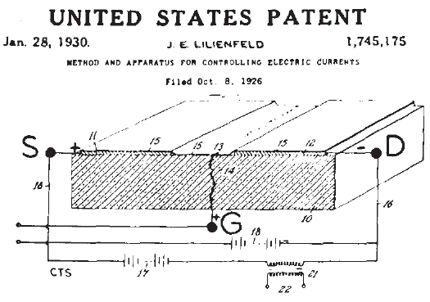
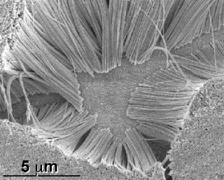
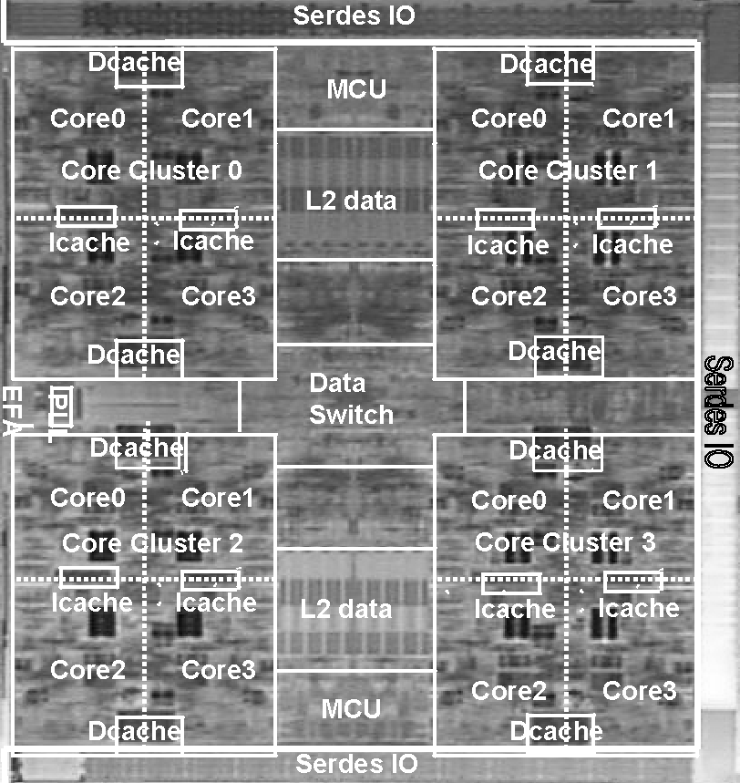
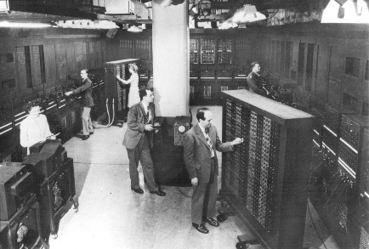
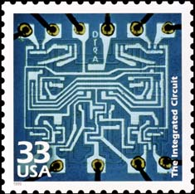

A Brief History
Conceptual transistor, by J.E. Lilienfeld, 1926
Electronics + biotechnology, ?
Multi-core processor, 2001
Eniac, ``the Giant Brain,” 1946
Functionality
Electronics + nanotechnology, ?
First transistor, 1947
Monolithic era
First IC, 1959
Number of devices
15
Notes:
Lilienfeld, Max Planc’s student. It had to take another two decades. In the mean time, we had to deal with vacuum tube based computing.

Slide 16
Point contact transistor
1947
Power germanium rectifier
1951
Tunnel diode 1957
Junction transistor
1950
Junction field-effect transistor (FET) 1951
Surface barrier transistor
1953
Photolithographic process
mid- 1950s
Oxide masking 1954
Diffused base transistor
1955
Commercial silicon junction transistor 1954
Schottky barrier diode 1960
Impatt diode (silicon) 1964
Zener diode 1952
Silicon controlled rectifier 1957
Metal oxide semiconductor (MOS) FET 1960
Monolithic IC 1958
Planar transistor 1959
Epitaxial transistor 1960
Commercial monolithic resistor-transistor logic 1961
Linear IC
1964
MOS IC
early 1960s
Complementary symmetry MOS (CMOS) 1963
Diode-transistor logic (DTL)
1962
Transistor-transistor logic (TTL)
1962
Emitter-coupled logic (ECL)
1962
Discrete transistors
IC’s or immediate predecessors
Power semiconductors
Microwave and optoelectronic devices
*G. Lapidus, “Transistor Family History,” IEEE Spectrum, pp. 34-35, January 1977.

Slide 17
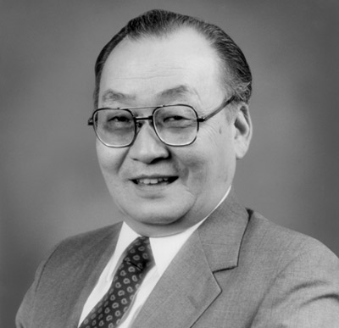
D. Kahng and M. Atalla MOSFET invented 1950
D. Kahng and S. Sze Floating Gate (Nonvolatile Memory) Cell Invented 1959– Chesse Cake Inspiration

Slide 18
Brief History of CMOS
Noyce produces
first fully integrated circuit
Dacey and Ross
implement FET
Wanlass
develops
first CMOS
inverter
Portable
applications
become
popular
Principle of MOSFET proposed
by Lelienfeld
Bardeen and
Brattain
invent transistor
IBM PC
announced
Logic:
100 Million +
transistors
1920
1952
1960
1965
2000
2010
1925
1947
1955
1962
1981
Memory:
64 Gigabits/chip
Shockley
invents
FET
Burns provides
analysis of
CMOS inverters
CMOS begins
dominance over
other technologies
IC’s have
5+ million
transistors,
100’s of MHz
Hoerni
develops
planar
process
Kilby makes
hybrid integrated
circuit

Slide 19

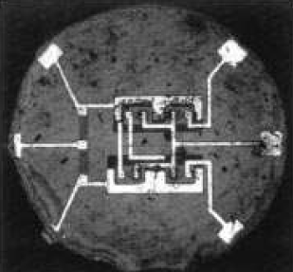

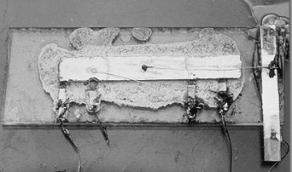
Evolution of Integrated Systems
Monolithic era
ENIAC, the “Giant Brain”
  ≈ 18,000 vacuum tubes
  174 kWatts
  ≈ 1800 ft²
  100 kHz
First transistor
First integrated circuit
16-core microprocessor
  410 million transistors
  250 watts
  396 mm²
  2.3 GHz
A reduction of ≈ 7200 mm²/day in area
A reduction of ≈ 7.5 watts/day in power
An increase of ≈ 100 kHz/day in speed
1946
1947
1958
2009
Time
19
Notes:
Fairchild IC: 4 transistors, one metal layer
Infineon IC: SiP for GSM/EDGE
60s, metal to polycrystalline and self aligned process (http://www.computerhistory.org/semiconductor/timeline/1968-SGT.html)
1963, cmos invented, but not adopted due to performance limit. (http://www.computerhistory.org/semiconductor/timeline/1963-CMOS.html)
Sub threshold mode logic
Dynamic logic

Slide 20
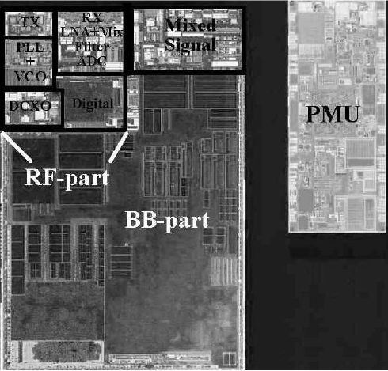
Evolution of Design Objectives
Design process is strongly driven by design constraints
Speed / Area
Speed
Speed / Power /
Noise
  Signal integrity
  Power integrity
  Robustness
Reliability
Predictability
Manufacturability
Area
Speed / Power
Fairchild Semiconductor
Power
Ultra low power
Infineon, monolithic transceiver
Yield concern
Limited integration
Higher integration
Transition to CMOS
Supercomputers
Subthreshold logic
Nanoscale dimensions
Very high integration
Heterogeneous systems
5 µm
1 µm
100 nm
22 nm
1960s
1970s
1980s
1990s
2000s
2010s
Time
E. Salman and E. G. Friedman, High Performance Integrated Circuit Design, McGraw-Hill, in preparation
20
Notes:
EMPHASIS HERE NOISE, AND GO TO HETEROG. SYSTEMS TO MOTIVATE NOISE Important to put the design process into perspective. Starts to behave like pure analog circuits where any two parameters trade with each other. Not surprisingly, the design time has increased. Design productivity.

Slide 21
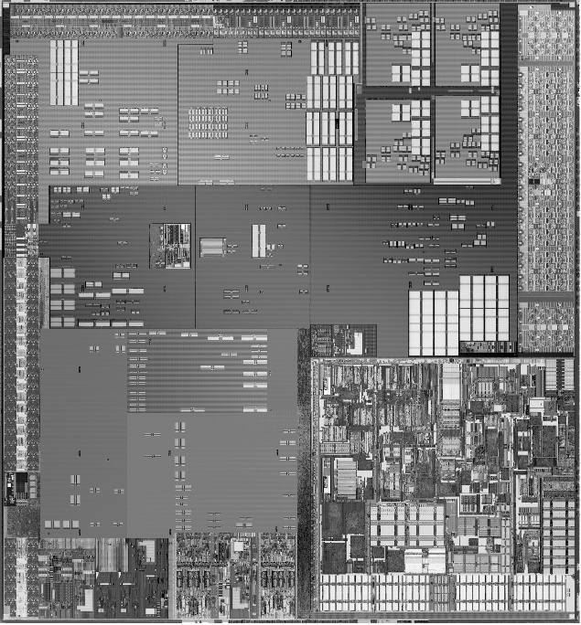
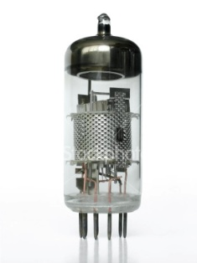
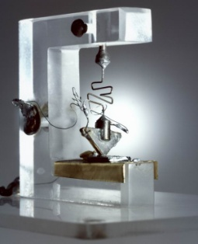
Physical Design in a Heterogeneous System
Power distribution
(Digital)
Power distribution
(Analog)
Digital
blocks
Clock
distribution
Sensitive
blocks
Global signaling
Intel, System-on-Chip, Tolapai
Infineon, monolithic transceiver
Ground distribution
(Digital)
Ground distribution
(Analog)
Physical design is more than the “layout” of an integrated circuit
Monolithic substrate
Monolithic substrate
Connectivity issue
E. Salman and E. G. Friedman, High Performance Integrated Circuit Design, McGraw-Hill, in preparation
21
Notes:
The device is smaller, much more reliable, but the connectivity problem is still there. That’s one of the most fundamental issues in the physical design, also referred to as interconnect problem. Depending upon our research focus, we see different aspects of these circuits. Assuming it is a synchronous system.

Slide 22
Implications of Physical Design Objectives
Clock distribution networks
Power distribution networks
Global signaling
Area
Speed
Power
22

Slide 23
Implications of Physical Design Objectives
Clock distribution networks
Power distribution networks
Global signaling
Signal integrity
Robustness
Power integrity
Noise
Area
Speed
Complex tradeoffs
Reliability
Power
Manufacturability
23

Slide 24
Electrical “Noise”
Analog/RF
  Device noise
    Shot
    Thermal
    Flicker
    Burst
Synchronous digital
  Switching noise
    Power/ground noise
    Crosstalk
    Delay uncertainty
Mixed-signal
  Substrate coupling noise
    Mitigation
    Efficient estimation
Injector
Substrate
Receiver
T _{min}
T _{max}
Increased robustness
Enhanced signal integrity
Reliable integration
24
Notes:
The perception of noise is quite different depending upon the type of circuit. In digital synchronous circuits, when we say noise, we primarily refer to switching noise. In mixed-signal circuits, where we have both digital and analog/RF circuits, coupling from digital to analog/RF becomes crictical. Mixed-signal circuits, 66% of the market today. Since switching noise is one of the primary constraints for physical design, I would like to give some more general background on physical design, and then come back to these problems.

Slide 25
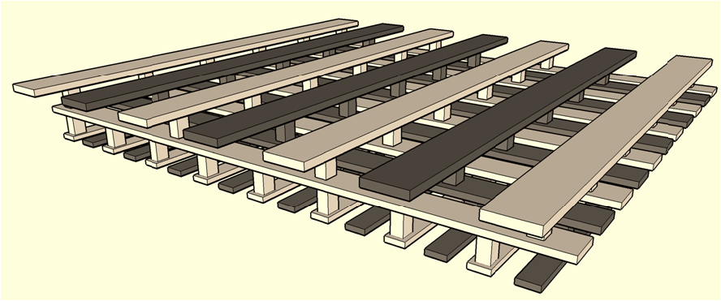
Power and Clock Distribution
Design
Analysis
  Topology
  Pad number and location
  Metal width and pitch
  Buffer placement
  Link insertion
  Decoupling capacitor
  Impedance extraction
  Decap estimation
  Load current modeling
  Global simulation
  Timing and power
25
Notes:
Traditionally area and electromigration, now noise and impedance

Slide 26
Global Signaling
Driver
Receiver
Circuit block 1
Circuit block 2
Aggressor
Victim
Design
Analysis
  Topology
  Metal width and pitch
  Signal quality
    Repeater
    Register
    Data recovery
  Impedance extraction
  Driver, receiver model
  Coupled interconnect
  Simulation
26
Notes:
Larger die area, higher transmission rates, signal integrity. To transfer signal from one signal block to another. Can be on-chip or off-chip. Traditionally, power, speed, still important, but now also noise, noise coupling.

Slide 27
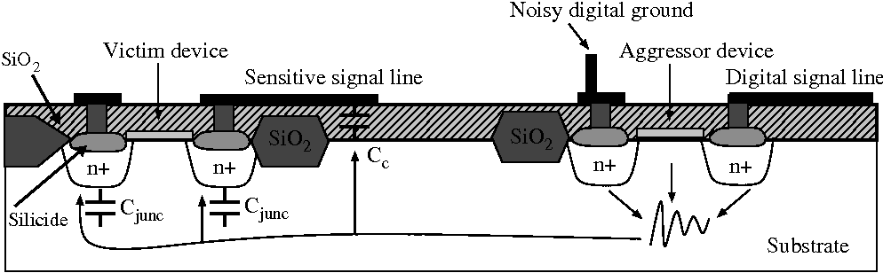
Substrate Coupling
LNA, data converter, wideband amplifier, bandgap circuit, …
Baseband digital, output buffers, power amplifier, …
Noise reduction
Analysis
  Injector
  Transmission medium
  Receiver
  Substrate extraction
  Power network extraction
  Aggressor circuit
27
Notes:
Mixed-signal circuits, if we exclude the pure memory circuits, it is 66% of the semiconductor market is mixed-signal circuits. The nature of the problem has changed.

Slide 28
Interdependent Physical Design
Loosely-coupled design methodologies produce less optimal circuits than co-dependent methodologies
Power distribution
(Digital)
Power distribution
(Analog)
Digital
blocks
Clock
distribution
Sensitive
blocks
Global signaling
Ground distribution
(Digital)
Ground distribution
(Analog)
Monolithic substrate
Monolithic substrate
28
Notes:
Refer to physical design conference. I have already shown how interdependence helps in reducing delay uncertainty. Make sure to continue publishing and pushing papers out. Natural extension of my work. We can improve not only signal integrity but also the performance of the circuit or reduce power dissipation. I have showed an example how considering the interdependence in timing constraints reduced pessimism and delay uncertainty with a more robust circuit. Here is another example of considering codependence.

Slide 29
Abstraction Level and Physical Constraints
``… to enable more efficient design space exploration, a new level of abstraction is needed …’’ ITRS 2009
``Raising the level of abstraction when designing chips”*
Productivity
Flexibility
How to handle physical constraints at higher levels of abstraction?
Higher level abstraction
Lower level abstraction
Physical information
A. Sangiovanni-Vincentelli, “Quo Vadis, SLD? Reasoning About the Trends and Challenges of System Level Design,” Proceedings of the IEEE, March 2007
29
Notes:
Trend for a higher abstraction level to handle complexity and increase productivity. I am not going to develop that abstraction level, but from my perspective, there is an issue here.

Slide 30




Technology Aware Physical Design
Design engineer
Process engineer
Design for manufacturability
Interconnect design at only two widths: minimum and maximum
  Implications on power-noise-speed-area?
  Compensation at different levels?
30
Notes:
There is always this tension between a design engineer and process engineer, although they don’t typically see each other, design engineer wants more relaxed rules, but the process engineer says you cannot do that. Maybe not this bad, but there is definitely a tension. And especially with the manufacturability being a primary design objective. How can we make physical design more technology aware.

Slide 31
Complexity Requirements of Large Scale Networks
``the tyranny of numbers’’ *
Substrate
Power/ground networks
  Millions of nodes
  Linear RLC network
Transistors
  Nonlinear
  Complicated device models
Substrate
  3-D RC mesh
  EM extraction
  FDM and BEM
Current
profile
Linearize
Jack Morton, Bell Laboratories, 1957
31

Slide 32
Bottleneck and Design Gap
Manufacturing
Bottleneck will shift
Design
Technology capabilities
Design gap
Design productivity
1981
2010
2025
Co-existence of “new” and “old” technologies
Design gap is expected to further increase
  Circuit and physical level challenges in heterogeneous integrated systems
  Mapping these opportunities to specific design objectives in physical computing systems
32
Notes:
As these technologies and devices get more mature, the bottleneck shifts from manufacturing to design, and we cannot wait to develop design methodologies and circuit challenges until it matures.

Slide 33
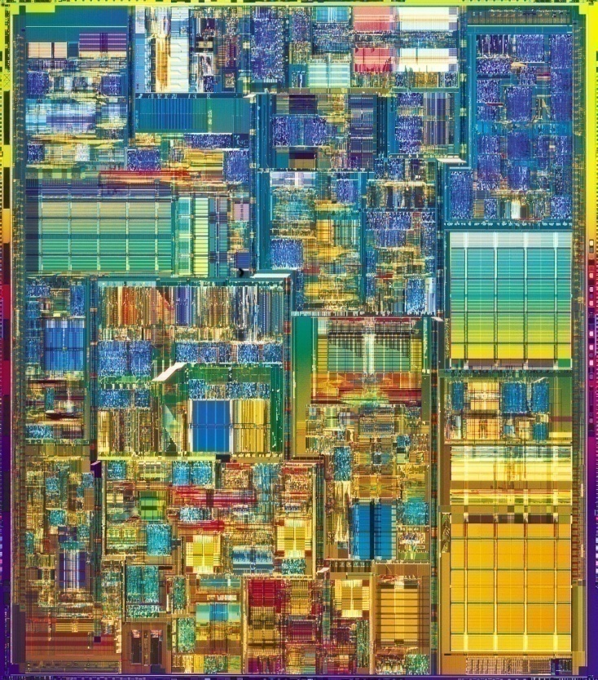
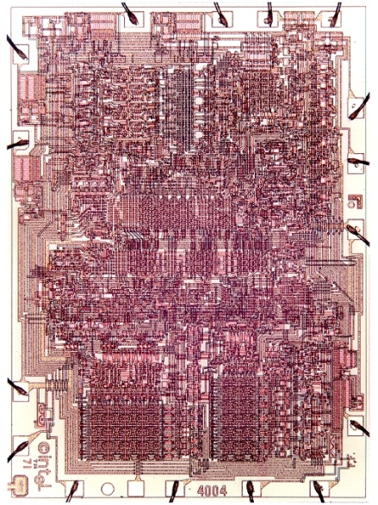
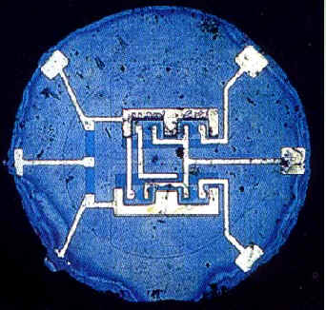
Advances in IC Technologies
A journey that started in 1959
First integrated circuit
Fairchild Semiconductor
1959
First microprocessor
Intel 4004
1971
Pentium 4
Intel Corporation
2002

Slide 34
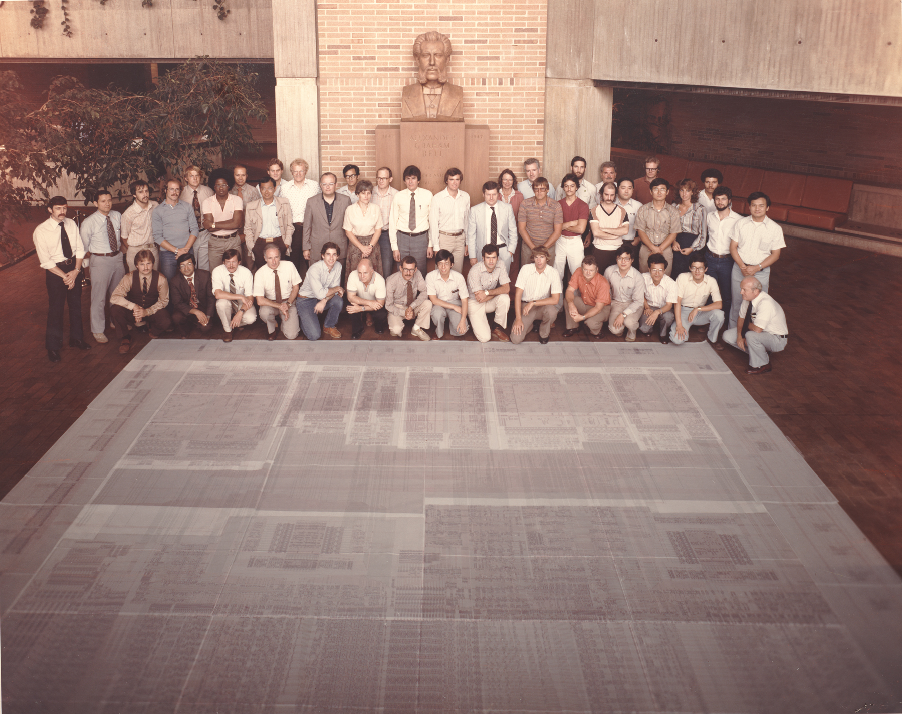
AT&T BELLMAC-32 TEAM at MH LOBBY (1981)
.

Slide 35
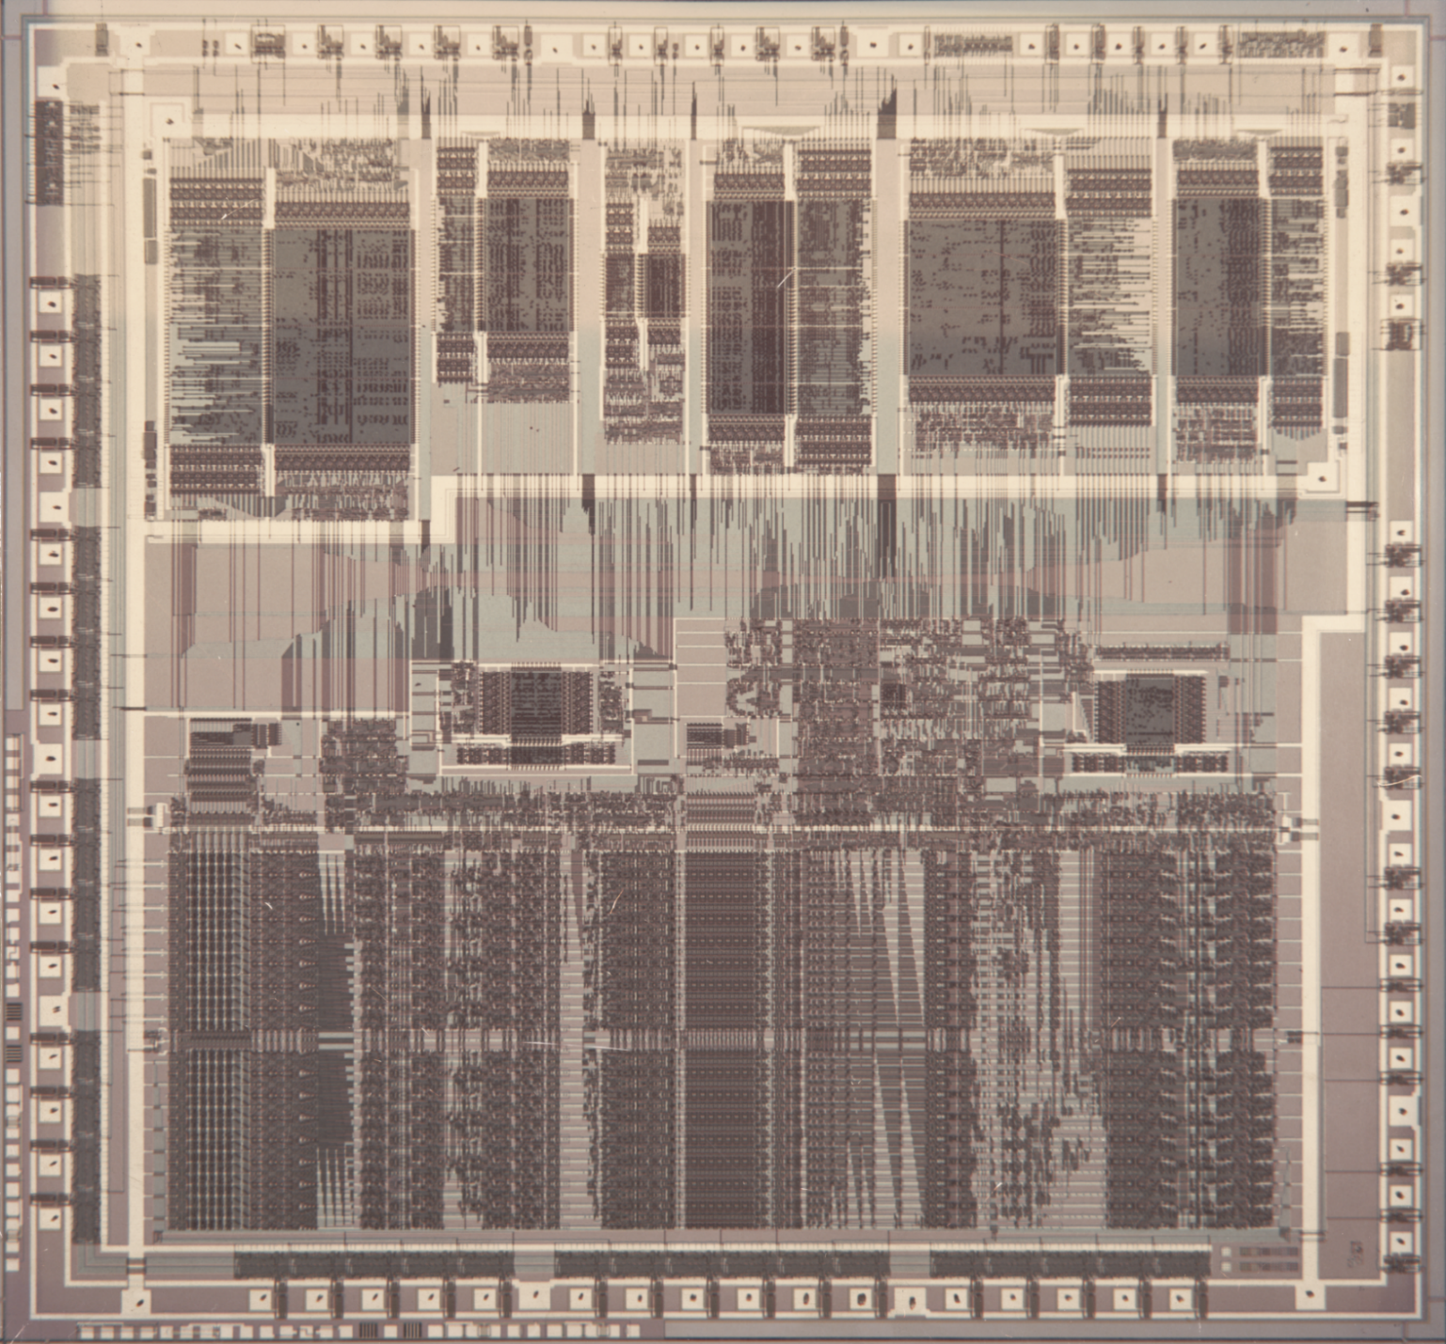
World’s First 32Bit CMOS Microprocessor BELLMAC-32
.

Slide 36
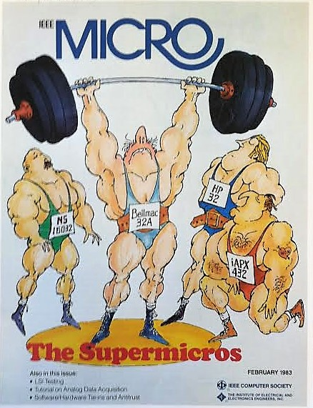
Mighty Then

Slide 37
Technology Scaling
Scaling of minimum feature size
  From 10 um in 1971 to 0.13 um in 2003
4004
8080
8085
8086
i286
i486
i386
Pentium
Pentium Pro
Pentium 2
Pentium 3
Pentium 4
Pentium D
Core
Core 2
Core i7
Notes:
37

Slide 38
Increasing Die Area
14% per year
  Additional circuitry to enhance performance and functionality
Pentium Pro
Pentium
Pentium 4
Core i7
Pentium 2
Core 2
i486
Pentium 3
Core
i386
Pentium D
i286
8086
8080
8085
4004
Notes:
38

Slide 39
Increasing Clock Frequency
Enhanced device performance
Innovative circuits and microarchitectures
Classical Scaling Era
Modern Era
Pentium D
Core
Core i7
Pentium 4
Core 2
Multicore
Pentium 3
Pentium 2
Pentium Pro
Pentium
i286
i386
i486
8086
~ 30,000x
8085
8080
4004
Notes:
39

Slide 40
Microprocessor Power Trends
Power consumption increases
Pentium D
Core
Core i7
Pentium 4
Core 2
NMOS to CMOS Transition
Pentium 2
Pentium Pro
Pentium 3
Pentium
i286
i486
8086
i386
8008
8080
8085
4004
Notes:
40

Slide 41
Power Density Trends
Power dissipation
Hot spots
Cost of cooling
  Low cost cooling
    Air flow fans
    Heat sinks
  Expensive cooling solutions
    Liquid cooling
    Refrigeration
Rocket Nozzle
Nuclear Reactor
Power Wall
Pentium D
Core
Core i7
Pentium 3
Core 2
Pentium 2
Pentium 4
8086
Pentium Pro
Hot Plate
i286
Pentium
8085
8080
i486
4004
i386
Notes:
41

Slide 42
Supply Voltage Scaling
Enhanced device reliability
Reduced power consumption
Classical Scaling Era
12 Volts
4004
8080
8085
i286
i386
i486
Pentium
5 Volts
8086
Pentium Pro
3.3 Volts
Pentium 2
Pentium 3
1.5 Volts
Pentium 4
Core
Core i7
Modern Era
Pentium D
Core 2
Notes:
42

Slide 43
Increasing Supply Current
Higher power at a lower supply voltage
  • Generation
  • Distribution
Power Wall
Core 2
Pentium D
Core i7
Pentium 4
Core
NMOS to CMOS Transition
Pentium Pro
Pentium 2
Pentium 3
Pentium
i286
8086
i486
8085
i386
8080
4004
Notes:
43

Slide 44
Supply Voltage Scaling
Enhanced device reliability in a scaled CMOS technology
Reduced power consumption
10.00
1.00
103 X
Power (normalized)
24 X
0.10
2.3 X
3.8 X
0.01
0.8
1.0
1.2
1.4
1.6
1.8
2.0
2.2
2.4
2.6
2.8
3.0
V
DD
(V)

Slide 45
Increasing Propagation Delays
Circuit speed degrades
5
4
3
V
DD
= 1.8 V
Delay (normalized)
4.4 X
6.3 X
2
1
0
0.8
1.0
1.2
1.4
1.6
1.8
2.0
2.2
2.4
2.6
2.8
3.0
V_{DD} (V)

Slide 46
Supply Voltage Scaling
V
DD
More than quadratic reduction in the dynamic switching power
  Switching frequency is reduced
More than linear reduction in the leakage power
  Subthreshold leakage
  Gate oxide leakage
I
Load
C
L
V
DD
I
Subthreshold
V
DD
0
C
L
I_{Gate-oxide}

Slide 47

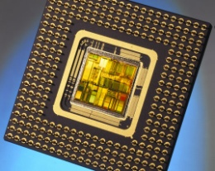
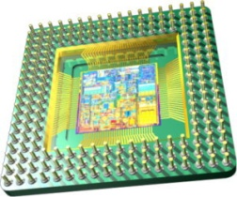
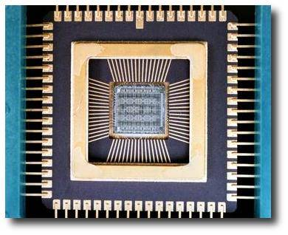
Emerging Technologies (Beyond CMOS)
Technology wall
Power - speed
wall
Noise wall
Emerging devices and technologies
Device level
  Carbon nanotubes
  Graphene based devices
  Multi-gate devices
  Resistive memory
  Memristors
Technology level
  3-D integration
  System-in-package
  On-chip optical interconnects
47
Notes:
From my perspective, the circuit and physical level challenges of these emerging devices and technologies is important. Scaling is expected to continue for another decade, but there are also emerging devices and techs. I will be interested in the circuit and physical level challenges of these new devices and technologies. of the Benefits of scaling is likely to end. Alternative opportunities. Gap further increases with the introduction of 3D, SiP, and other emerging opportunities…
Mention some 3d physical design challenges

Slide 48
Summary
Signal integrity
Robustness
Power integrity
Area
Noise
Speed
Physical design challenges
Reliability
Power
Manufacturability
Delay uncertainty
Synchronous digital
Noise
Mixed-signal
Substrate coupling
Design methodologies
Heterogeneous integrated systems
Design automation
Specialized circuits
48
Notes:
I summarized some of the challenges in the physical design, especially with the emergence of new design constraints. I presented some of our research results related to increasing the robustness and efficiently estimating substrate coupling noise which is important for improving signal integrity. Finally, I proposed a framework for future research which has three domains. 1, 2, and 3, for heterogeneous embedded systems.

Slide 49
Evolution of IC Design Objectives
Speed / area
Speed
Speed / power / noise
Area
Speed / power
Power
Ultra low power
Ultra low power
Yield concern
Limited integration
Higher integration
New applications
Three paths of design objectives
Very high integration
Complex SoCs
RF, analog, and digital on the same die
Intel 4004
Intel 386
Intel Pentium
Multi core era
1970s
1980s
1990s
2000s
Time
M. Popovich, A. V. Mezhiba, and E. G. Friedman, Power Distribution Networks with On-chip Decoupling Capacitors, Springer Verlag, 2008
Notes:
Advances in the fabrication technology 2) emergence of new applications
60s and 70s: Yield concern is the primary limitation to integration density. Therefore, circuit compactness and area were the primary design objectives. Due to limited integration density, a typical system was composed of many small integrated circuits where the performance was limited by the inter-chip communication.
Due to the advances in the fabrication technology, system speed became a stronger function of the single ICs. Therefore, in 80s,
Speed gained a very high priority as a design objective. At the same time, a new set of applications emerged where power also became very important. These applications include digital wrist watches, handheld calculators, and some satellite electronics.
Later in 90s, with even higher integration, speed and power had to be considered at the same time, resulting in three different paths of design objectives. Ultralow power where speed is not important. Very high speed applications where power is tolerated and those applications where speed and power are optimized at the same time.
Starting 2000, the primary trend was to integrate different functions on the same die such as analog, RF, and digital to reduce the overall cost. A new design metric emerged which was noise.

Slide 50
Design Goals of CMOS Integrated Circuits
Speed/Area
Speed
Speed/Power/Noise
POWER/Noise/speed
Area
Speed/Power
Power
Ultra-Low Power
1970’s
1980’s
1990’s
2000’s
2010’s

Slide 51
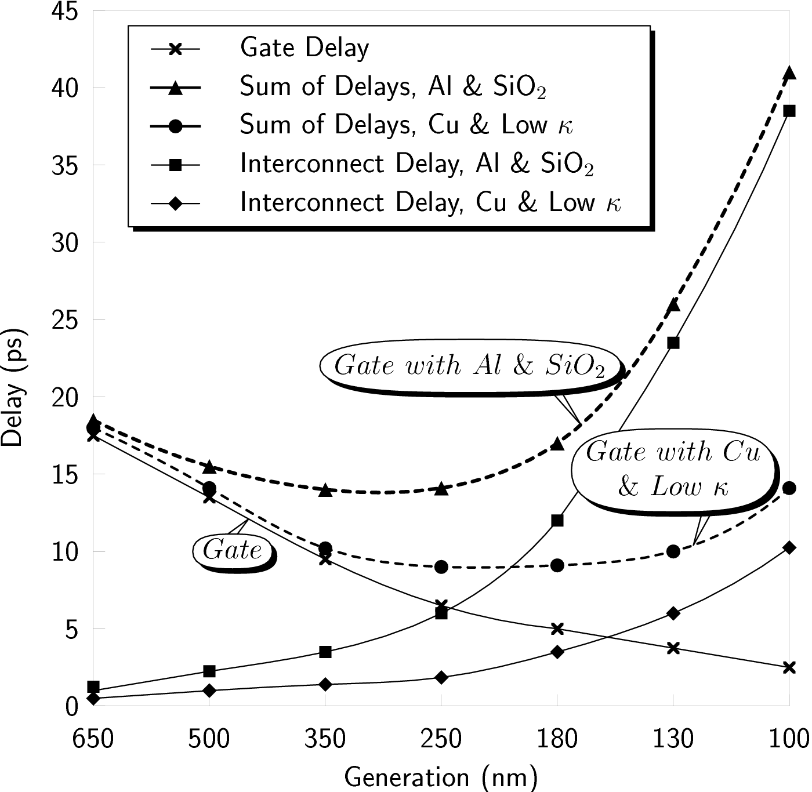
Speed/Performance Issues
Al 3.0 μΩ - cm
Cu 1.7 μΩ - cm
SiO₂ κ = 4.0
Low κ κ = 2.0
Al & Cu 0.8 μm Thick
Al & Cu Line 43 μm Long
Gate and interconnect delay versus technology generation
The National Technology Roadmap for Semiconductors, 1997

Slide 52
Evolution of IC Design Objectives
Speed / area
Speed
Speed / Power / Noise
Area
Speed / Power
1959
Power
Ultra low power
2008
Yield concern
Limited integration
Higher integration
New applications
Transition to CMOS
Supercomputers
Subthreshold logic
Very high integration
Complex SoCs
RF, analog, and digital on the same die
4 µm
0.8 µm
0.1 µm
0.045 µm
1960s
1970s
1980s
1990s
2000s
2010s
Time
52
M. Popovich, A. V. Mezhiba, and E. G. Friedman, Power Distribution Networks with On-Chip Decoupling Capacitors, Springer Verlag, 2008
Notes:
Fairchild IC: 4 transistors, one metal layer
Infineon IC: SiP for GSM/EDGE
60s, metal to polycrystalline and self aligned process (http://www.computerhistory.org/semiconductor/timeline/1968-SGT.html)
1963, cmos invented, but not adopted due to performance limit. (http://www.computerhistory.org/semiconductor/timeline/1963-CMOS.html)
Sub threshold mode logic
Dynamic logic

